Slide 1
M.KUMARASAMY COLLEGE OF ENGINEERING , DEPT OF CSE – B.E
Class : III CSE B
Batch no : 09
Date : 26.03.2024
1

Slide 2
PREDICTIVE MODELING OF SLEEP APNEA
Name of the Candidates : NITHIN KUMAR D A
RAJA S
SAI PRASANTH R
SANJAY S
Register Numbers : 927621BCS075
927621BCS088
927621BCS096
927621BCS097
Name of the Supervisor : Mrs.G.RAMYA SHRI M.E.,
with Designation
26/03/2024
(18CSP304L) MINOR PROJECT IV - FIRST REVIEW
2

Slide 3
Objectives of the Project
Develop a machine learning model for early detection and prognostic assessment of Sleep Apena.
Enable personalized healthcare interventions by stratifying individuals based on their risk of developing Sleep Apena.
Integrate predictive models into clinical workflows to support decision-making and patient management.

Slide 4
Literature Review
TITLE | AUTHOR | YEAR | SUMMARY
Pediatric sleep-disordered breathing: Clinical features | Marcus CL | 2005 | This review paper focuses on sleep-disordered breathing in children, including the diagnosis and management of pediatric obstructive sleep apnea.
Wearable technology for sleep monitoring | de Zambotti M et al | 2019 | This review paper focuses on wearable technologies for sleep monitoring, including devices capable of detecting sleep apnea-related parameters such as respiratory events and sleep fragmentation..

Slide 5
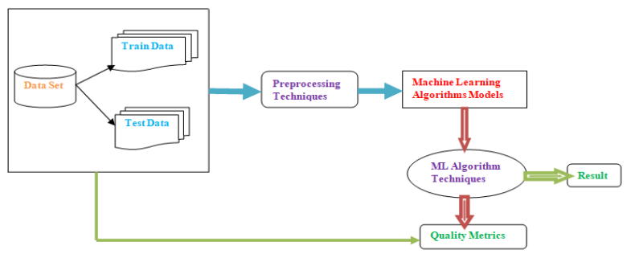
Existing System Architecture

Slide 6
Proposed System Architecture-Findings
Proposed system architectures for sleep apnea in machine learning utilize feature extraction from physiological signals like respiratory and heart rate variability, with classification models such as SVMs, random forests, and Logistic Regression.
Handling data imbalance and validation through cross-validation techniques ensure robust performance evaluation.
Real-time monitoring via wearable devices and integration with healthcare systems enable practical deployment for clinical use, albeit challenges remain in interpretability and generalizability.

Slide 7
Proposed System Architecture
dataset
user
Decision tree algorithm
User input
Output
Training model
Predicted output
API

Slide 8
Modules in Project
Data Collection and Preprocessing
Feature Engineering and Selection
Model Development and Training
Model Evaluation and Validation
Developing APIs
Developing Front-end
Connecting API with Front-end

Slide 9
Summary of Module -1
Data Collection and Preprocessing
Gather diverse medical data of patient link Blood Pressure, Sleep Dueration, Stress Level ,etc….
Clean the data by handling missing values, outliers, and inconsistencies..

Slide 10
Summary of Module -2
Feature Engineering and Selection
Identify relevant features from the medical data that correlate with sleep apnea presence or severity.
Engineer new features that capture meaningful relationships or interactions within the data..

Slide 11
Summary of Module - 3
Model Development and Training
Choose suitable machine learning algorithms such as logistic regression, random forest, or Support Vector Machine.
Split the data into training and validation sets for model training and evaluation.
Train the selected models on the training data, optimizing hyperparameters using techniques like grid search or Bayesian optimization.

Slide 12
Summary of Modules -4
Model Evaluation and Validation
Evaluate the trained models using performance metrics such as accuracy, precision, recall, and area under the ROC curve (AUC).
Validate the models on an independent test dataset to assess their generalization ability.
Perform cross-validation to ensure robustness and reliability of the models across different subsets of the data.

Slide 13
Summary of Modules -5
Developing as API
This module aims to equip learners with the knowledge and skills required to develop robust and efficient APIs (Application Programming Interfaces) using Python.
Through this module, participants will delve into the fundamentals of API development, learn about various Python framework like flask commonly used for API development, and explore best practices to create scalable and maintainable APIs.
Evaluate the trained models using performance metrics such as accuracy, recall, and area under the ROC

Slide 14
Summary of Modules -6
Developing as Front-End
React.js is a popular JavaScript library for building user interfaces, especially for single-page applications where UI updates are frequent.
At its core, React.js utilizes a component-based architecture, where UIs are broken down into reusable components.
React promotes a declarative programming style, where developers describe how the UI should look at any given point in time, and React takes care of updating the DOM to match that description efficiently.

Slide 15
Summary of Modules -7
Connecting Front-end with API
Event-driven architecture: Allows handling of multiple concurrent connections efficiently.
Asynchronous I/O operations: Non-blocking nature enables handling of many requests concurrently without getting blocked.
Single programming language: Using JavaScript for both server-side and client-side development simplifies code sharing and enhances developer productivity.
Cross-platform: Node.js is compatible with Windows, macOS, and Linux, providing flexibility in deployment.

Slide 16
Software & Hardware Requirements Specification
HARDWARE REQUIREMENTS
Processor :Intel,AMD any versions
Ram: 4GB and more(Installed memory)
SOFTWARE SPECIFICATION
OS: Windows.
Languages used for front end and backend: HTML,CSS,JAVASCRIPT and Python

Slide 17
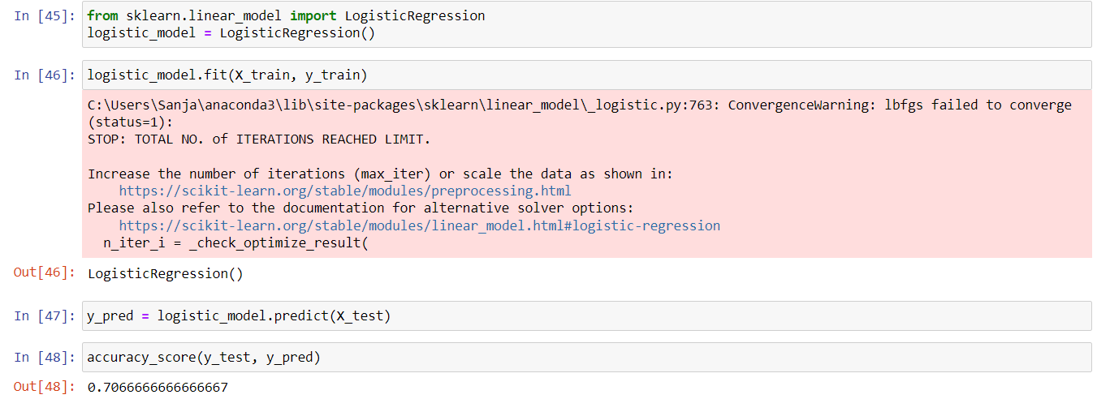
Implementation of Modules

Slide 18
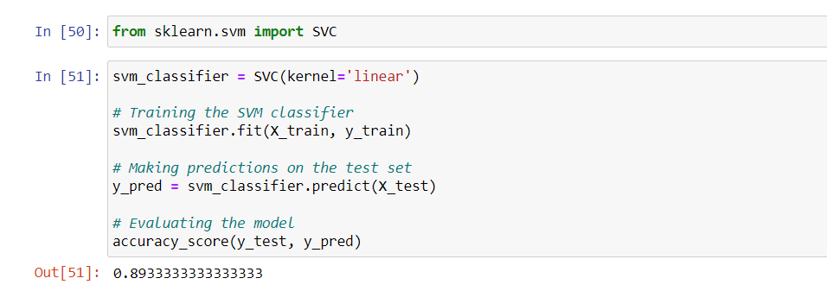
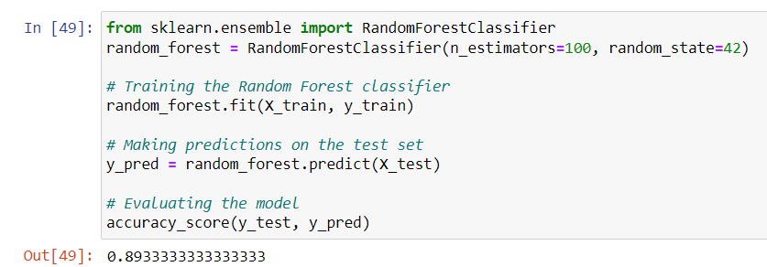

Slide 19
Conclusion
In summary, our machine learning approach effectively predicts sleep apnea, enabling early detection and personalized care. By leveraging diverse data sources, we've developed accurate models with clinical utility, highlighting the potential of AI in improving Sleep Apena management. Further validation and integration into clinical practice are essential for maximizing the impact of this innovative approach..

Slide 20
References
https://www.who.int/news-room/fact-sheets/detail/the-top-10-causes-of-death
https://www.geeksforgeeks.org/support-vector-machine-algorithm/
https://www.kaggle.com/datasets/uom190346a/sleep-health-and-lifestyle-dataset

Slide 21


